Slide 1
Electroacoustics
Kierunek „Elektronika”, rok II

Slide 2
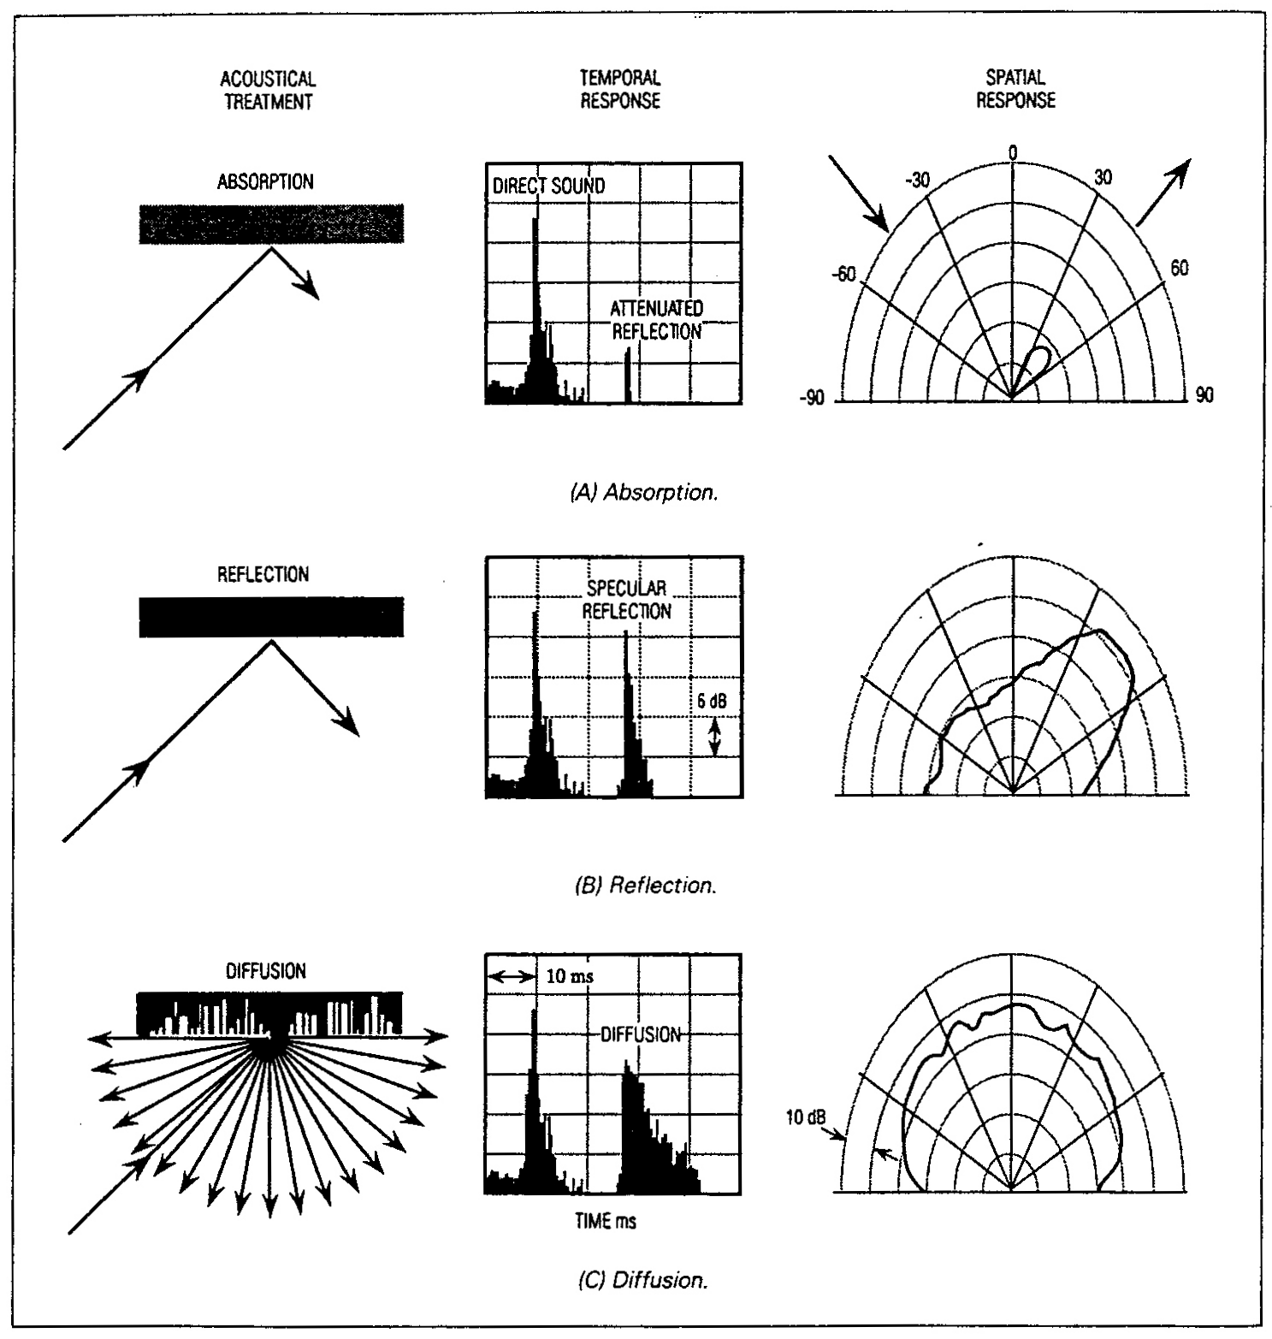
Acoustic field in rooms

Slide 3
Frequency ranges
Lumped
parameters
Wave theory
Statistical
Geometrical
theory
theory
c
T_{p}
f
=
2000
4
f
k
V
k
2
L
Frequency

Slide 4
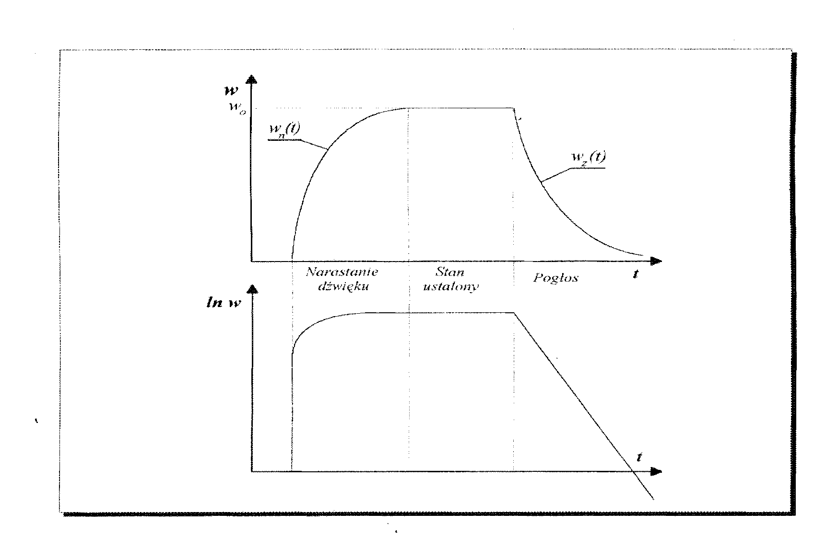
Rise and decline of sound in a room
Rise
Steady state
Reverberation

Slide 5
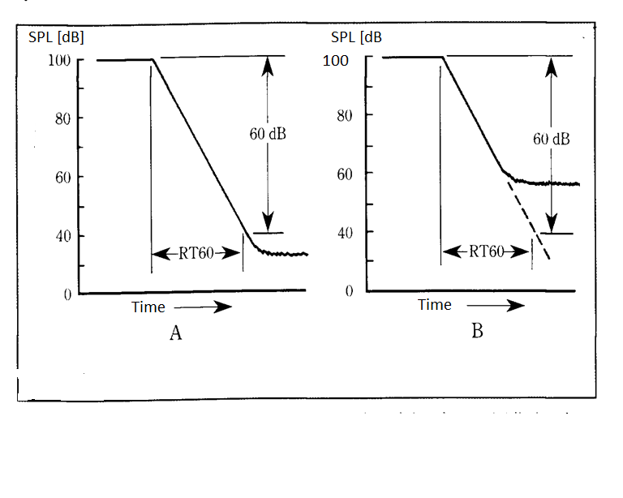
Reverberation Time RT60

Slide 6
Formulas for RT60 (according to statistical theory)
Formula of Sabine
Formula of Eyring
Formula of Knudsen (with absorption in the air)

Slide 7
Absorbtion according to Eyring i Sabine
Ey(α) – effective absorption coefficient according to Eyring

Slide 8
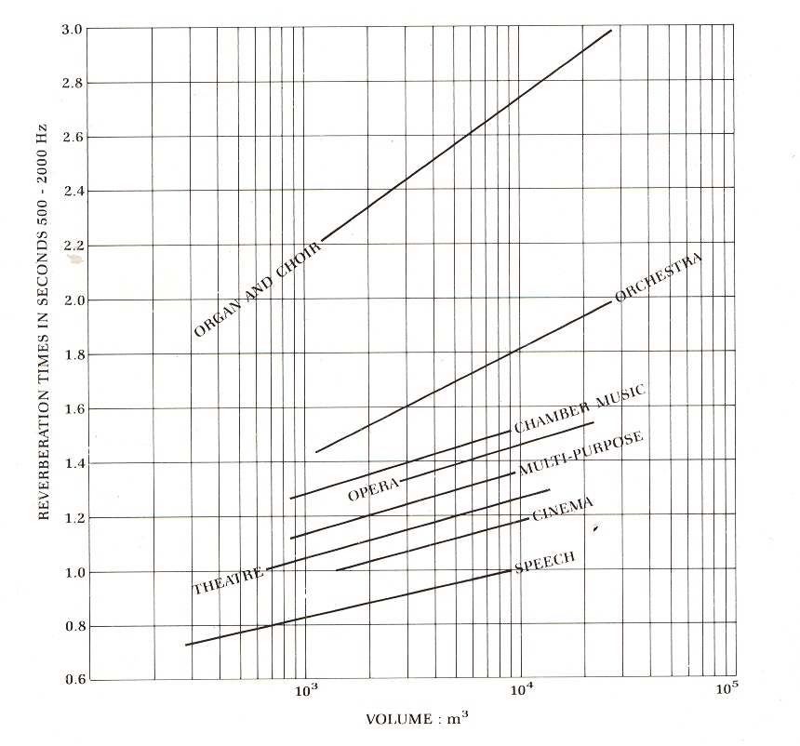
Recommended reverberation time

Slide 9
Sound absorbing materials

Slide 10
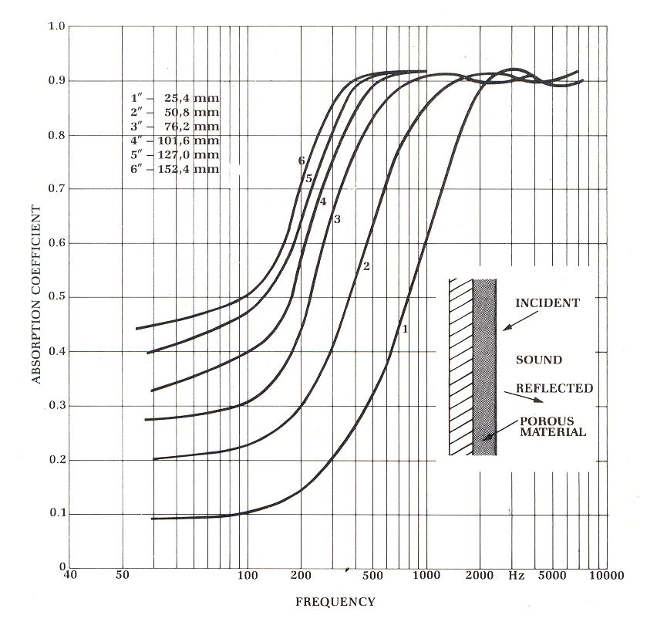
Absorption coefficients of porous materials

Slide 11
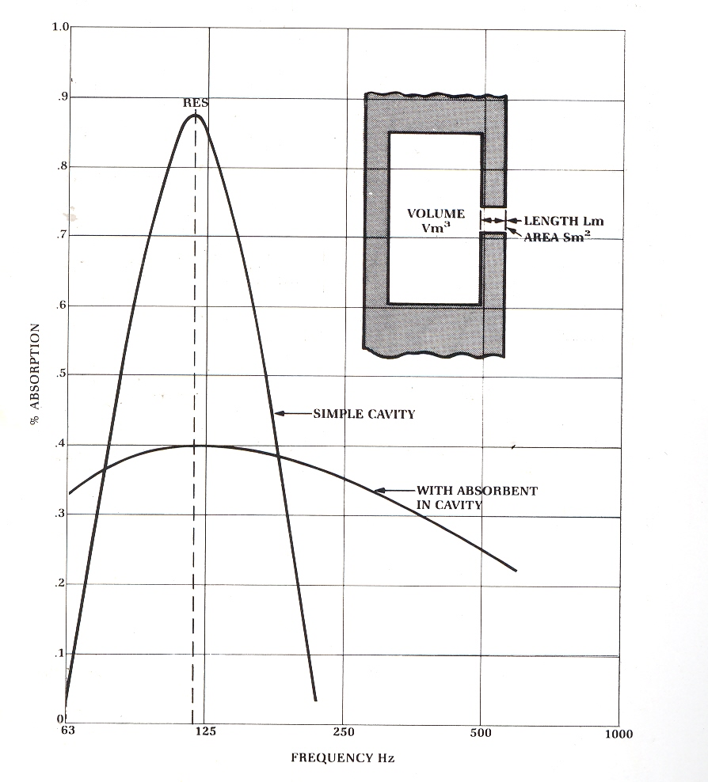
Absorption coefficient of Helmholtz resonator

Slide 12
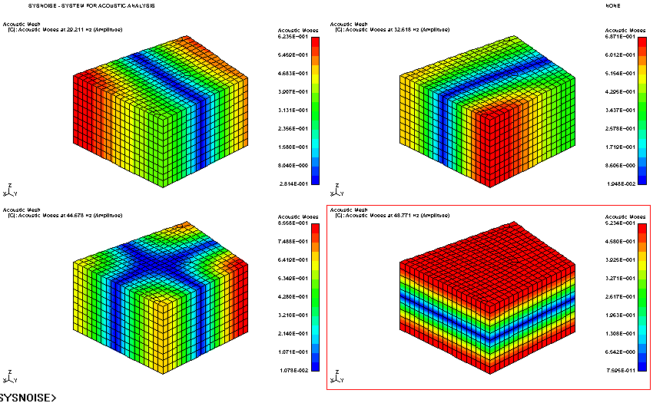
Room resonances according to wave theory
(Room No. 607 C-5)

Slide 13
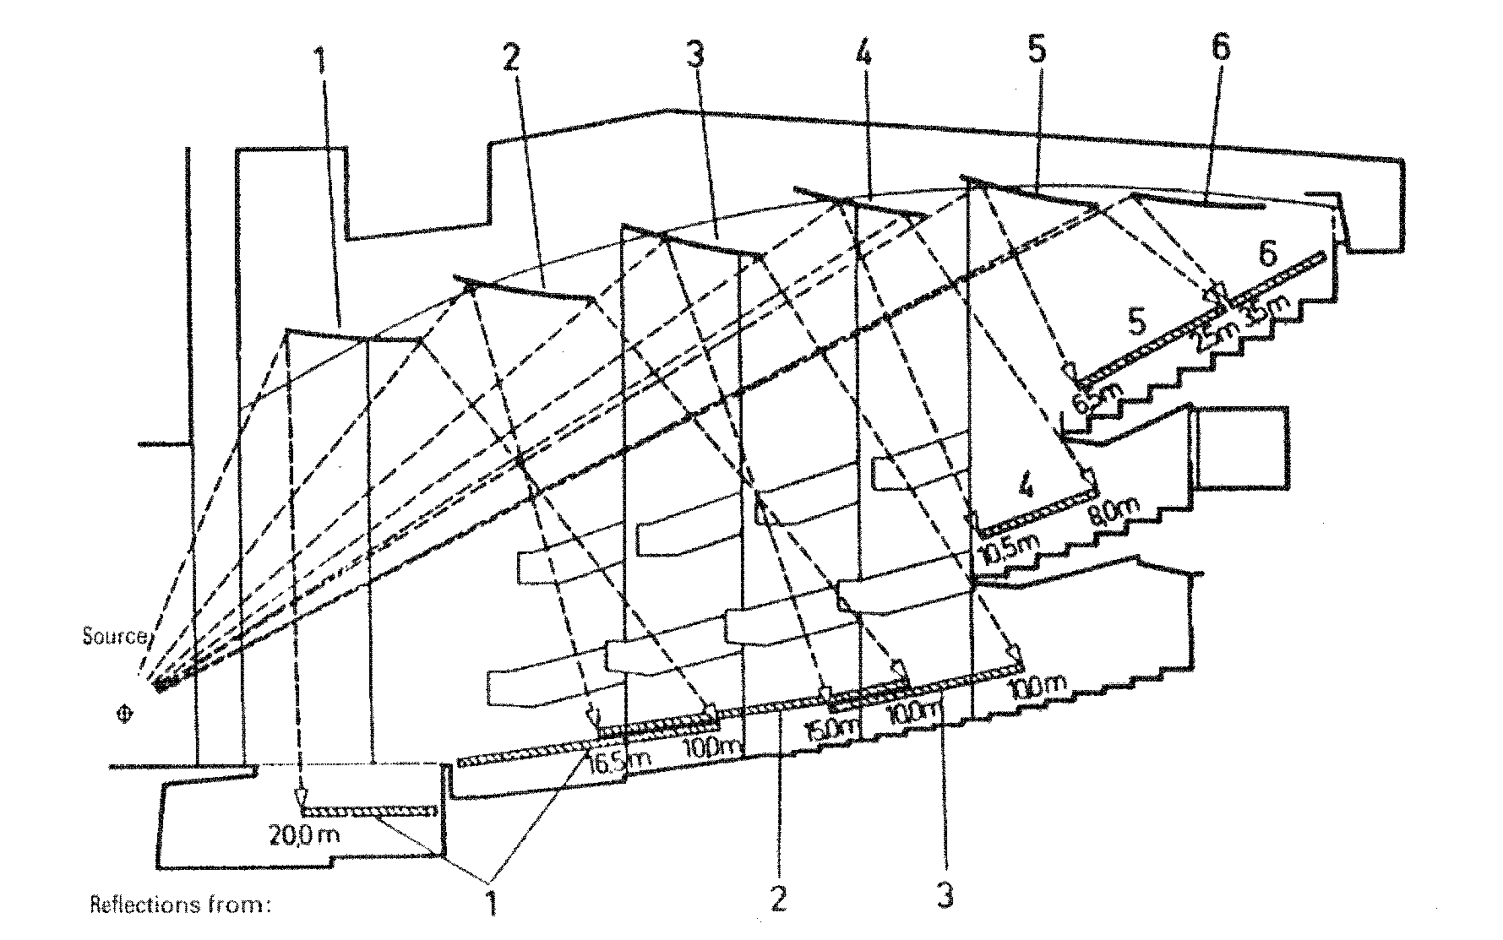
Geometrical theory

Slide 14
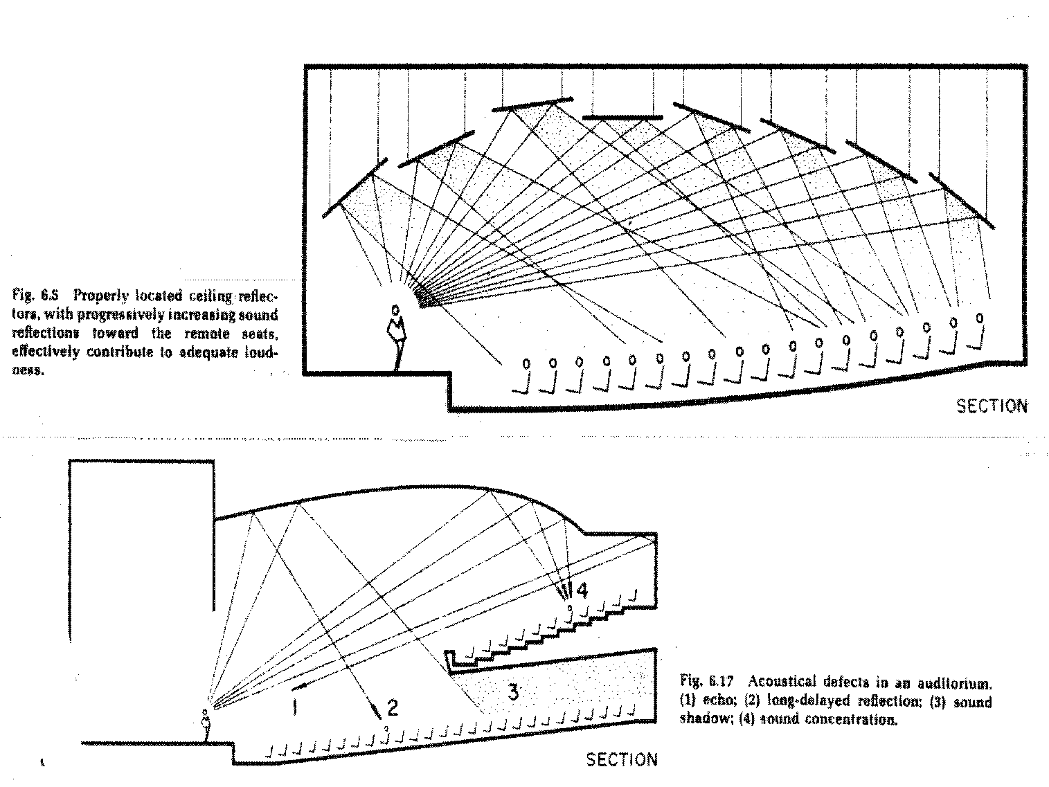
Design of large halls

Slide 15
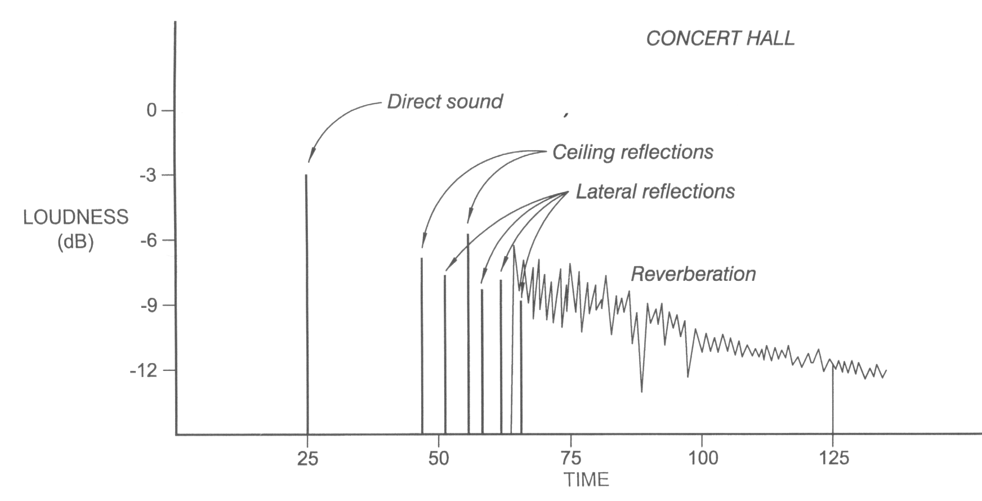
Echogram

